Slide 1


Slide 2
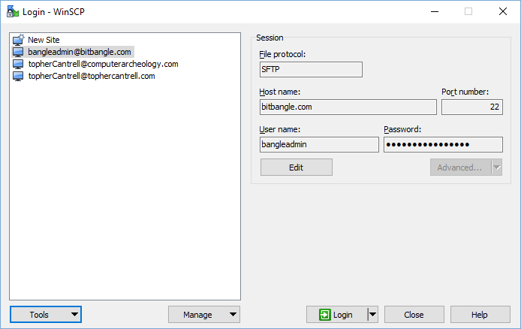
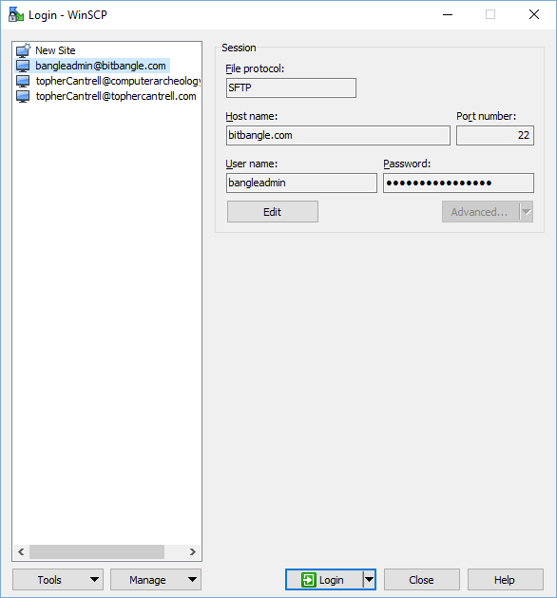
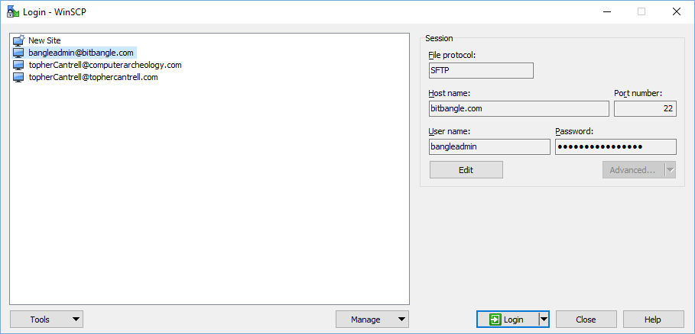
Complex Example

Slide 3
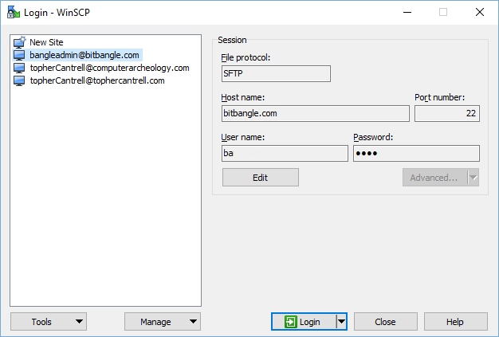
Main Layout
Border Layout
JPanel
JPanel
EAST
CENTER

Slide 4
Left Side
JTextArea
CENTER
JPanel
WEST
EAST
SOUTH

Slide 5
Right Side
JPanel
NORTH
SOUTH

Slide 6
Right Side
EAST
GRID

Slide 7
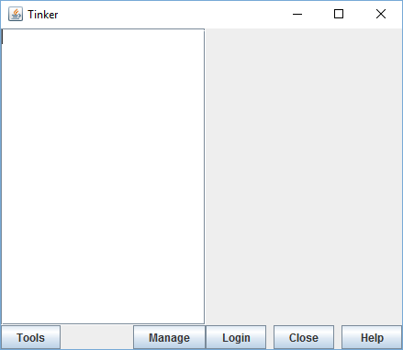
JPanel leftButtons = new JPanel(new BorderLayout());
leftButtons.add(BorderLayout.WEST,new JButton("Tools"));
leftButtons.add(BorderLayout.EAST,new JButton("Manage"));
JPanel left = new JPanel(new BorderLayout());
left.add(BorderLayout.CENTER,new JScrollPane(new JTextArea(20,20)));
left.add(BorderLayout.SOUTH,leftButtons);
JPanel mainPanel = new JPanel(new BorderLayout());
mainPanel.add(BorderLayout.CENTER,left);
JPanel buttonGrid = new JPanel(new GridLayout(1,3,8,8));
buttonGrid.add(new JButton("Login"));
buttonGrid.add(new JButton("Close"));
buttonGrid.add(new JButton("Help"));
JPanel rightButtons = new JPanel(new BorderLayout());
rightButtons.add(BorderLayout.EAST,buttonGrid);
JPanel right = new JPanel(new BorderLayout());
right.add(BorderLayout.SOUTH,rightButtons);
mainPanel.add(BorderLayout.EAST,right);
JFrame jf = new JFrame("Tinker");
jf.setDefaultCloseOperation(JFrame.DISPOSE_ON_CLOSE);
jf.setContentPane(mainPanel);
jf.pack();
jf.setVisible(true);

Slide 8
Form Panel
WEST
EAST
NORTH
SOUTH

Slide 9
Form Panel
NORTH
NORTH
SOUTH
NORTH
SOUTH
WEST
EAST
SOUTH

Slide 10
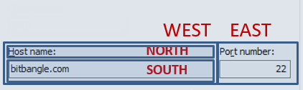
Form Helper Function
public static JPanel makeFormPanel(String leftLabel, int leftSize, String rightLabel, int rightSize) {
JPanel ret = new JPanel(new BorderLayout());
JPanel left = new JPanel(new BorderLayout());
left.add(BorderLayout.NORTH,new JLabel(leftLabel));
left.add(BorderLayout.SOUTH,new JTextField(leftSize));
ret.add(BorderLayout.WEST,left);
if(rightLabel!=null) {
JPanel right = new JPanel(new BorderLayout());
right.add(BorderLayout.NORTH,new JLabel(rightLabel));
right.add(BorderLayout.SOUTH,new JTextField(rightSize));
if(rightSize==0) {
ret.add(BorderLayout.CENTER,right);
} else {
ret.add(BorderLayout.EAST,right);
}
}
return ret;
}

Slide 11
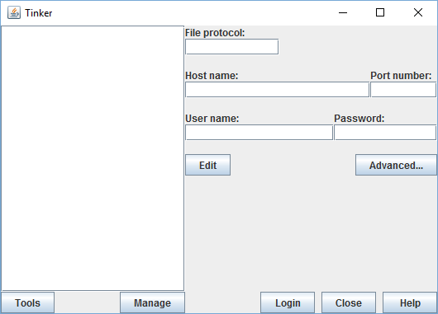
mainPanel.add(BorderLayout.EAST,right);
JPanel rightA = makeFormPanel("File protocol:",10, null,0);
JPanel rightB = makeFormPanel("Host name:",20, "Port number:",8);
JPanel rightC = makeFormPanel("User name:",16, "Password:",0);
JPanel panA = new JPanel(new BorderLayout(0,8));
JPanel panB = new JPanel(new BorderLayout(0,8));
JPanel panC = new JPanel(new BorderLayout(0,8));
panA.add(BorderLayout.NORTH,rightA);
panA.add(BorderLayout.SOUTH,rightB);
panB.add(BorderLayout.NORTH,rightC);
panC.add(BorderLayout.NORTH,panA);
panC.add(BorderLayout.SOUTH,panB);
JPanel panD = new JPanel(new BorderLayout());
panD.add(BorderLayout.WEST,new JButton("Edit"));
panD.add(BorderLayout.EAST,new JButton("Advanced..."));
panB.add(BorderLayout.SOUTH,panD);
right.add(BorderLayout.NORTH,panC);
JFrame jf = new JFrame("Tinker");

Slide 12
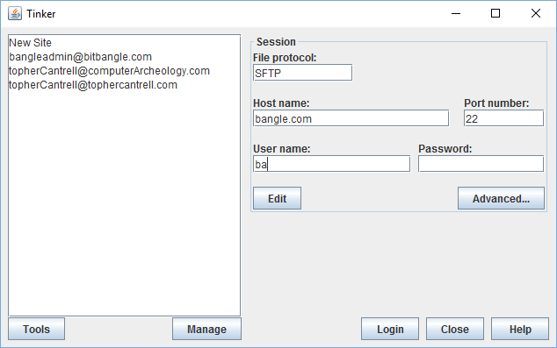
Borders
JPanel mainPanel = new JPanel(new BorderLayout(8,0));
mainPanel.setBorder(BorderFactory.createEmptyBorder(8,8,8,8));
panC.setBorder(BorderFactory.createTitledBorder("Session"));
JPanel ret = new JPanel(new BorderLayout(8,0));

Slide 13
import java.awt.BorderLayout;
import java.awt.GridLayout;
import javax.swing.BorderFactory;
import javax.swing.JButton;
import javax.swing.JFrame;
import javax.swing.JLabel;
import javax.swing.JPanel;
import javax.swing.JScrollPane;
import javax.swing.JTextArea;
import javax.swing.JTextField;
public class WinSCP {
public static JPanel makeFormPanel(String leftLabel, int leftSize, String rightLabel, int rightSize) {
JPanel ret = new JPanel(new BorderLayout(8,0));
JPanel left = new JPanel(new BorderLayout());
left.add(BorderLayout.NORTH,new JLabel(leftLabel));
left.add(BorderLayout.SOUTH,new JTextField(leftSize));
ret.add(BorderLayout.WEST,left);
if(rightLabel!=null) {
JPanel right = new JPanel(new BorderLayout());
right.add(BorderLayout.NORTH,new JLabel(rightLabel));
right.add(BorderLayout.SOUTH,new JTextField(rightSize));
if(rightSize==0) {
ret.add(BorderLayout.CENTER,right);
} else {
ret.add(BorderLayout.EAST,right);
}
}
return ret;
}

Slide 14
public static void main(String[] args) {
JPanel leftButtons = new JPanel(new BorderLayout());
leftButtons.add(BorderLayout.WEST,new JButton("Tools"));
leftButtons.add(BorderLayout.EAST,new JButton("Manage"));
JPanel left = new JPanel(new BorderLayout());
left.add(BorderLayout.CENTER,new JScrollPane(new JTextArea(20,20)));
left.add(BorderLayout.SOUTH,leftButtons);
JPanel mainPanel = new JPanel(new BorderLayout(8,0));
mainPanel.setBorder(BorderFactory.createEmptyBorder(8,8,8,8));
mainPanel.add(BorderLayout.CENTER,left);
JPanel buttonGrid = new JPanel(new GridLayout(1,3,8,8));
buttonGrid.add(new JButton("Login"));
buttonGrid.add(new JButton("Close"));
buttonGrid.add(new JButton("Help"));
JPanel rightButtons = new JPanel(new BorderLayout());
rightButtons.add(BorderLayout.EAST,buttonGrid);
JPanel right = new JPanel(new BorderLayout());
right.add(BorderLayout.SOUTH,rightButtons);
mainPanel.add(BorderLayout.EAST,right);
JPanel rightA = makeFormPanel("File protocol:",10, null,0);
JPanel rightB = makeFormPanel("Host name:",20, "Port number:",8);
JPanel rightC = makeFormPanel("User name:",16, "Password:",0);
JPanel panA = new JPanel(new BorderLayout(8,8));
JPanel panB = new JPanel(new BorderLayout(8,8));
JPanel panC = new JPanel(new BorderLayout(8,8));
panC.setBorder(BorderFactory.createTitledBorder("Session"));

Slide 15
panA.add(BorderLayout.NORTH,rightA);
panA.add(BorderLayout.SOUTH,rightB);
panB.add(BorderLayout.NORTH,rightC);
panC.add(BorderLayout.NORTH,panA);
panC.add(BorderLayout.SOUTH,panB);
JPanel panD = new JPanel(new BorderLayout());
panD.add(BorderLayout.WEST,new JButton("Edit"));
panD.add(BorderLayout.EAST,new JButton("Advanced..."));
panB.add(BorderLayout.SOUTH,panD);
right.add(BorderLayout.NORTH,panC);
JFrame jf = new JFrame("Tinker");
jf.setDefaultCloseOperation(JFrame.DISPOSE_ON_CLOSE);
jf.setContentPane(mainPanel);
jf.pack();
jf.setVisible(true);
}
}

